Slide 1
SWITCHING CAREERS
Tilman Fabricius

Slide 2
“
“Let’s be honest:
Data Analytics sucks!
”
- Anonymous Quote-

Slide 3
FOOD
Everybody loves:

Slide 4
WHAT TO DO?
I live in the City Center
I live above a Restaurant
Space might be available
I WILL OPEN A RESTAURANT

Slide 5
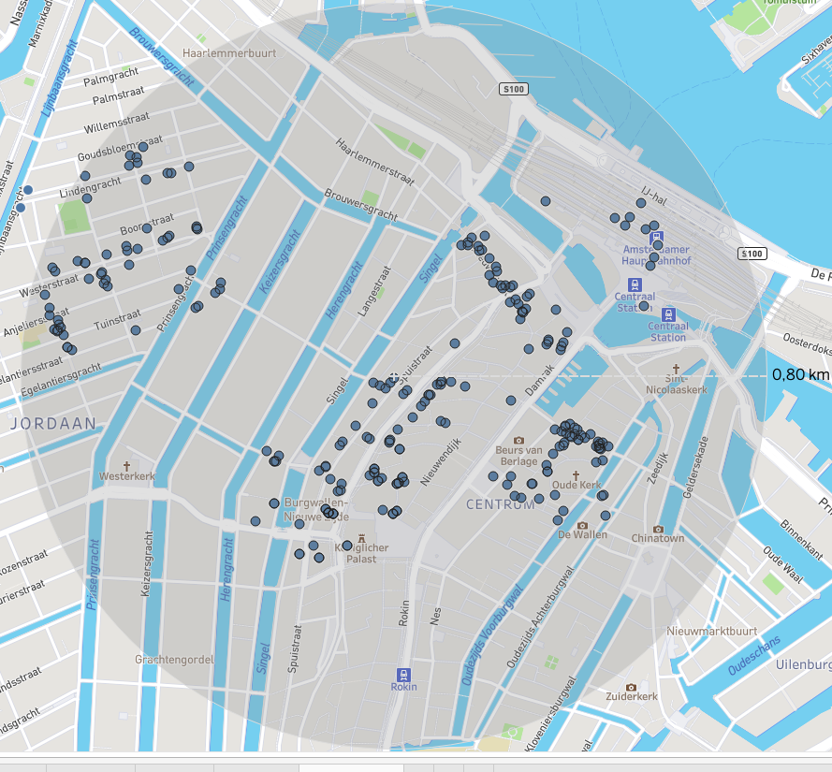
APPROACH
Looking at all restaurants around my location
Looking for the option with the highest chance of success

Slide 6
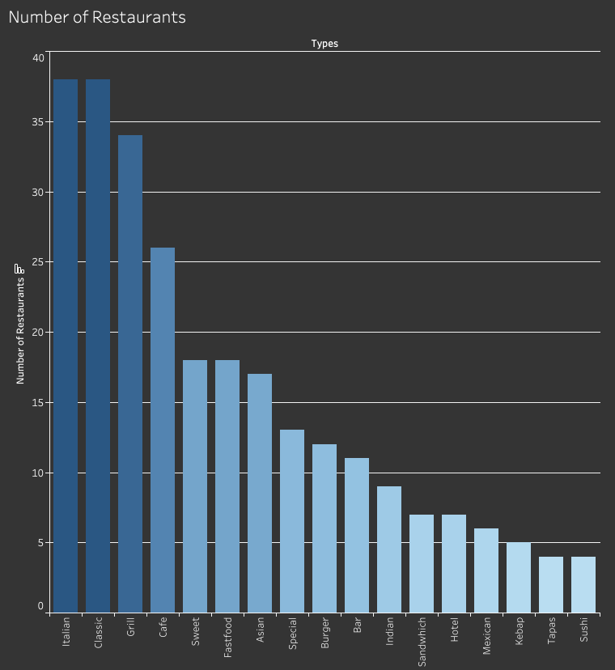

Slide 7
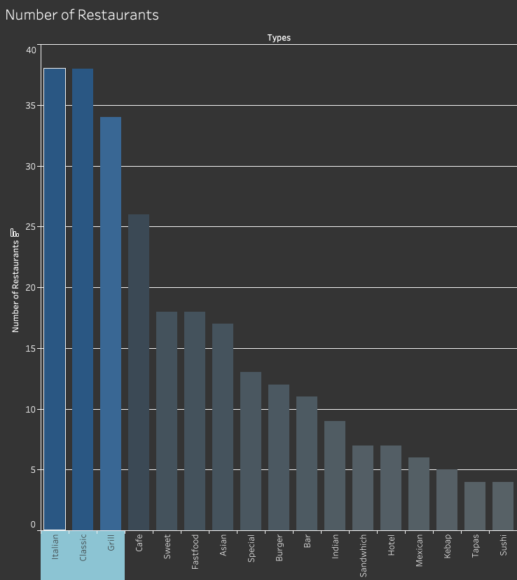

Slide 8
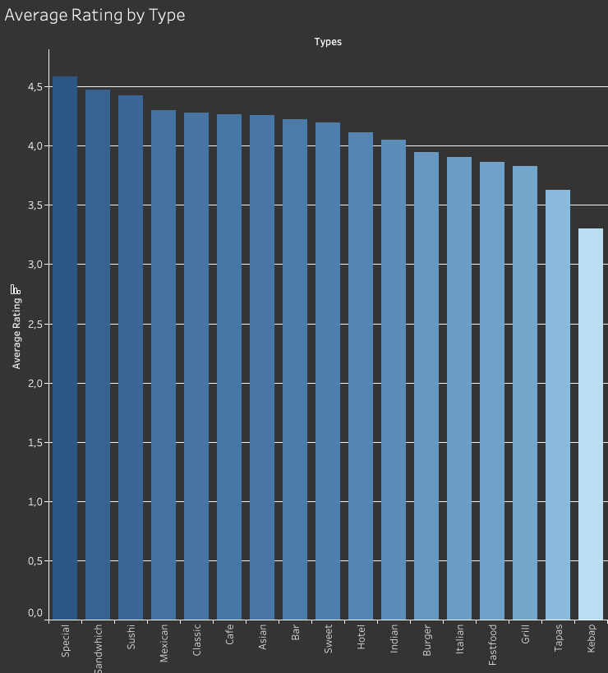

Slide 9
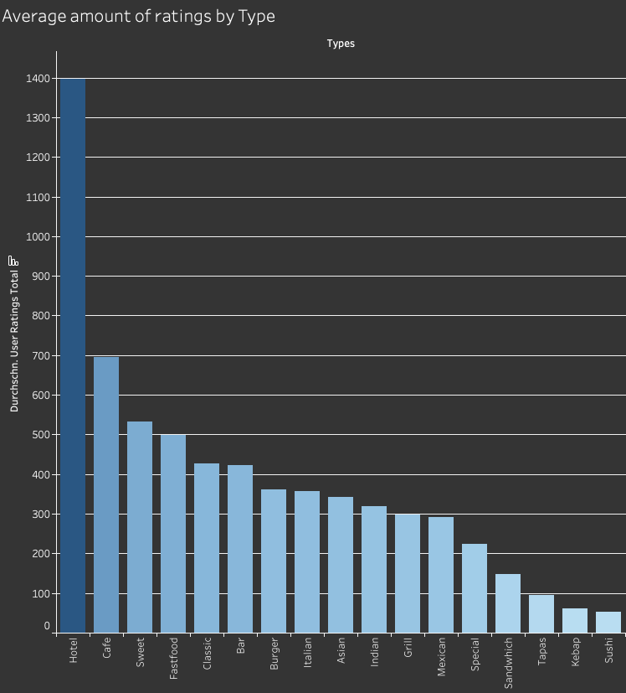

Slide 10
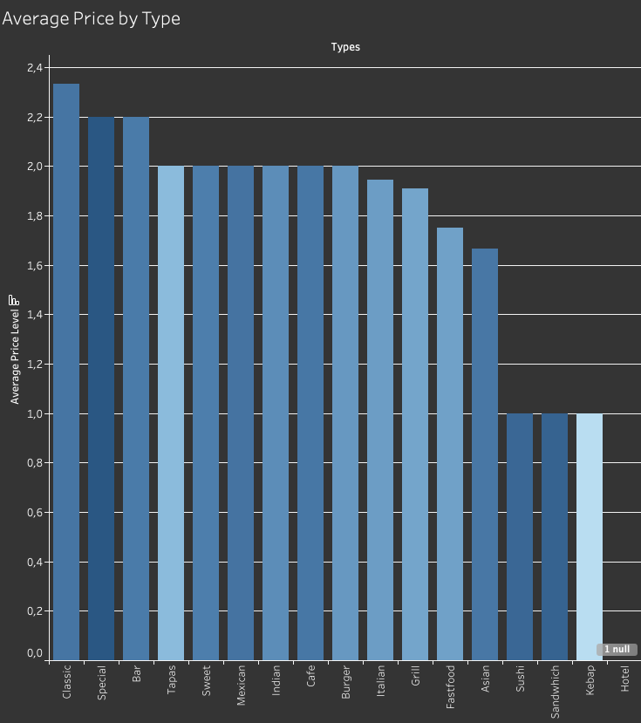

Slide 11
PROBLEMS
No correlation between price, amount of ratings and the rating
Multiple conclusions from the data

Slide 12
LOCATION
Location,Location,Location
- Harold Samuel -

Slide 13
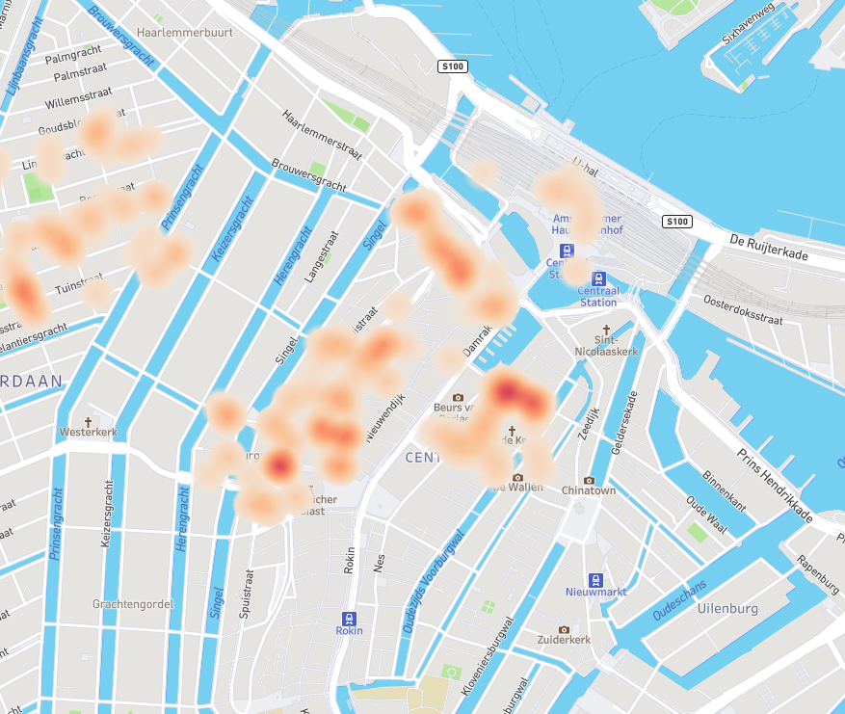

Slide 14
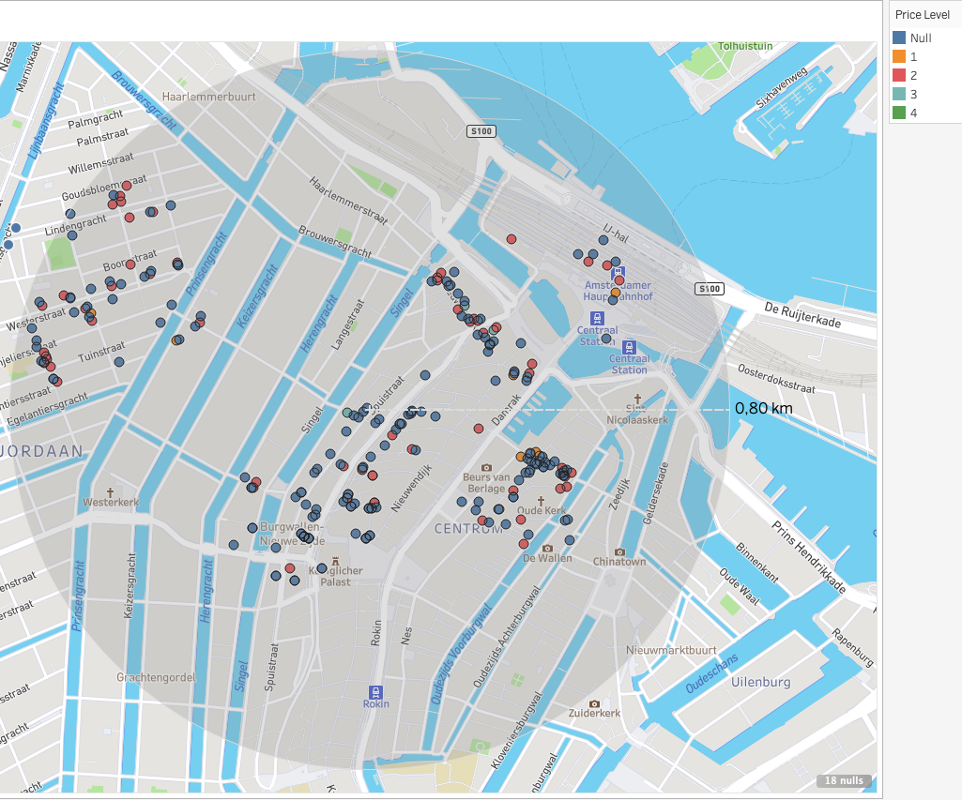

Slide 15
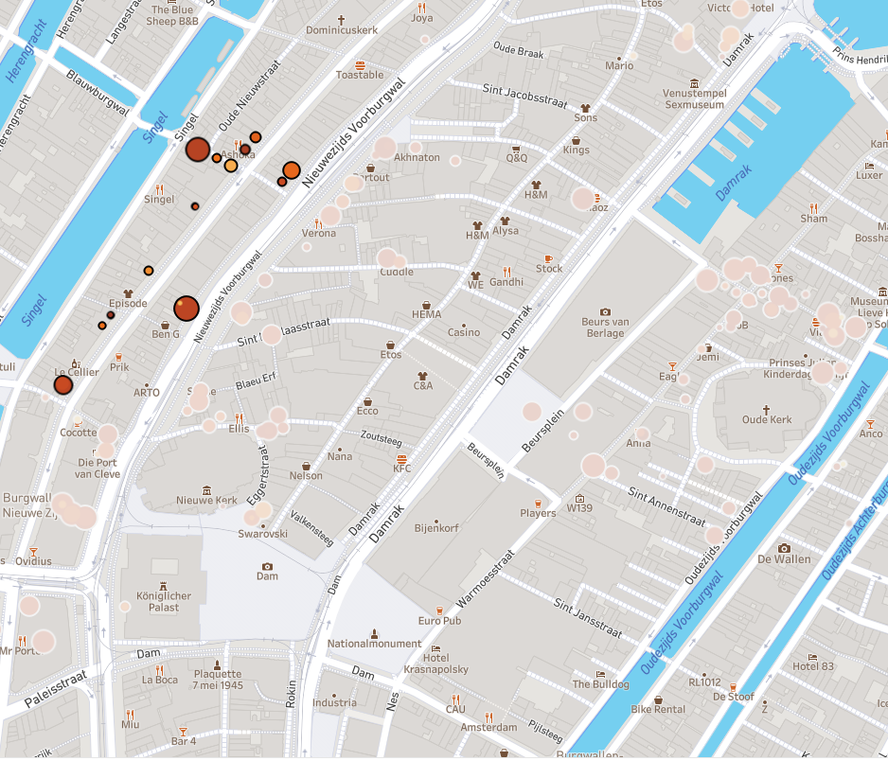

Slide 16
CONCLUSION
Maybe Fusion (Kitchen)

Slide 17
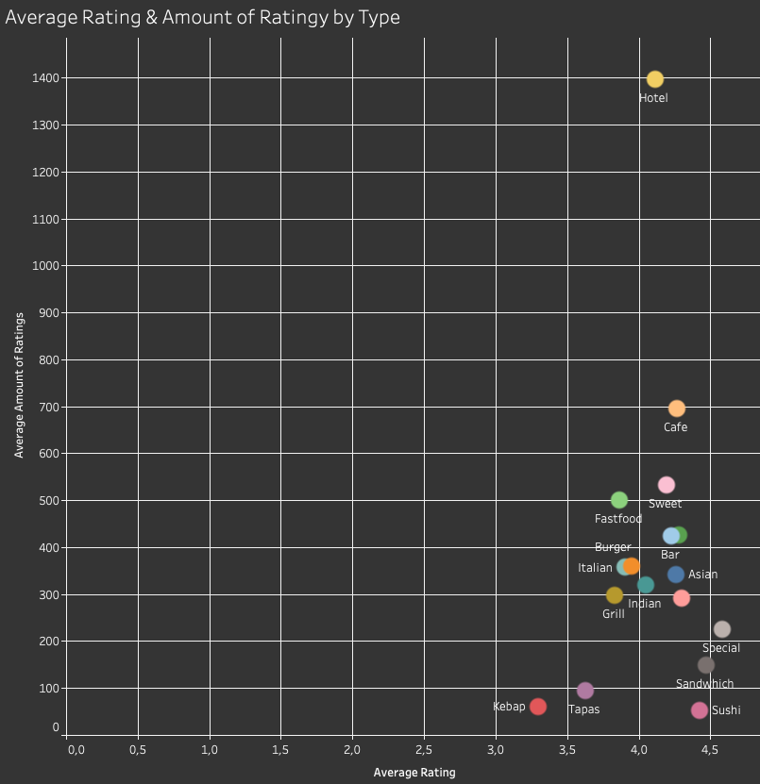

Slide 18


Slide 19


German Sandwich Shop
Bretzel, Brot & Butter

Slide 20
Thanks!

